Slide 1

Adventure Works Analysis Insights
By Mark Galperin

Slide 2

Executive summary
The business shows strong fundamentals with a steady growth trend from 2017 to 2019 and a clear seasonal sales advantage in Q2 and Q4.
High profitability from the Components category (₪950K) and dominant performance of warehouse and VAR resellers (₪37M and ₪32M respectively) highlight scalable, strategic channels.
However, inefficiencies persist in the Road Bikes segment (₪11.3M revenue, ₪1.05M loss) and in underperforming regions like the Southeast (sales <₪700K).
Additionally, pricing misalignment in high-end products suggests optimization is needed in premium tiers.
Immediate focus should be placed on margin recovery, regional enablement, and pricing strategy refinement.

Slide 3
Product segment insights

Slide 4
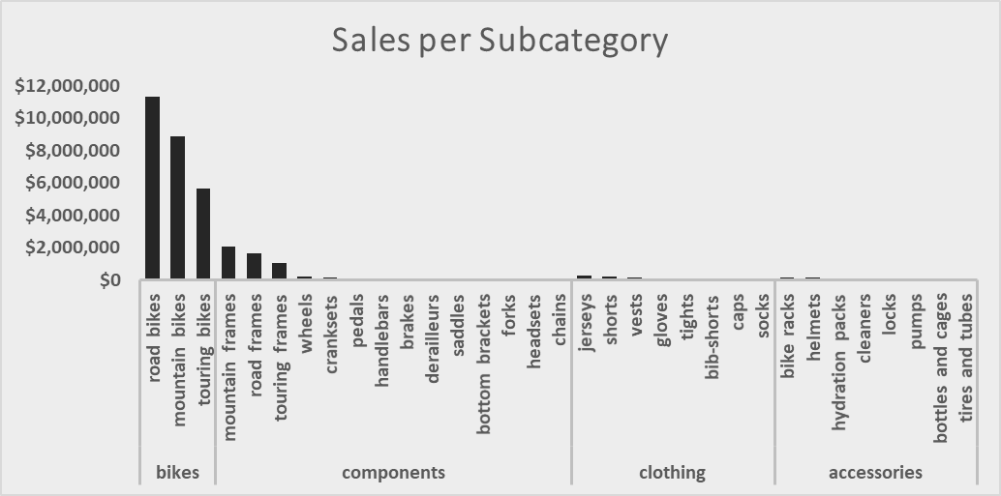
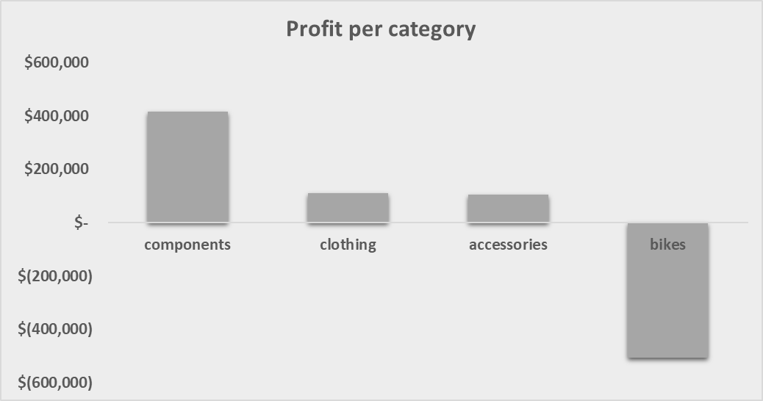
Bikes accounted for over ₪25M in revenue, yet posted a net loss of ~₪487K, mainly due to Road Bikes (₪11.3M revenue, −₪1.05M profit).
Components category achieved the highest profit of ~₪950K, despite lower sales volume – led by subcategories like Mountain Frames.
Mountain Bikes generated ₪8.8M revenue with positive profitability, making them a strategic growth area.
Shift Toward High-Margin Categories - Revenue from Accessories and Components is gradually increasing, reflecting a potential market shift toward profitable add-ons rather than just high-volume bike sales.
Sales Efficiency Gaps Emerging - While revenue increased, profitability stagnated or declined in major categories ,signaling a possible inefficiency in cost or pricing structure.

Slide 5
Quote
Regional Performance

Slide 6
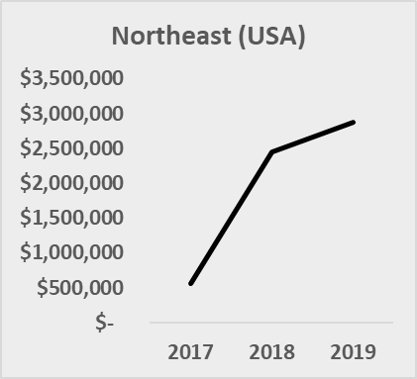
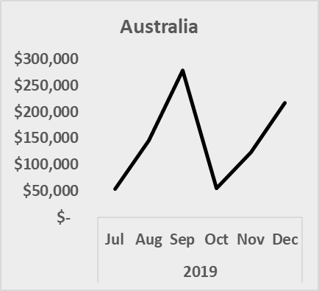
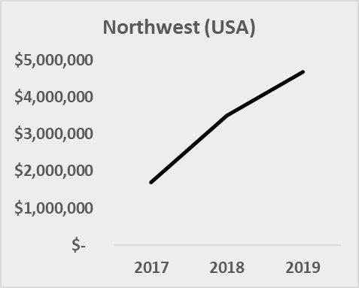
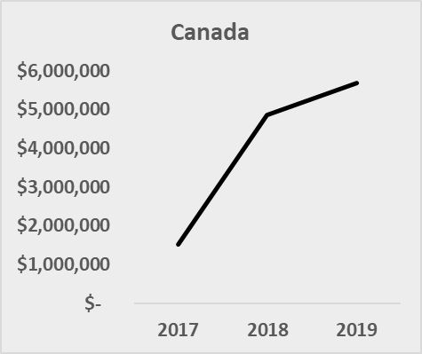
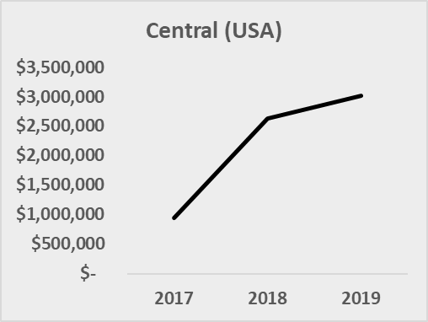
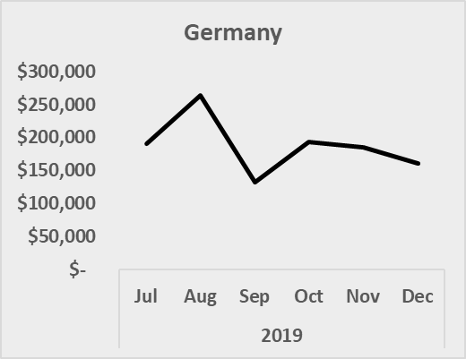
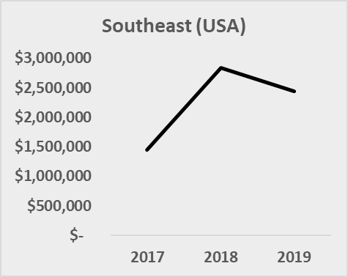
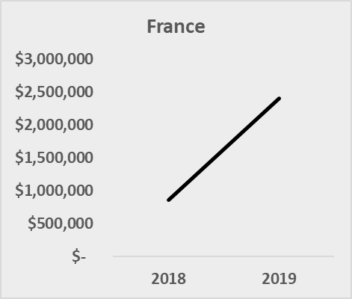
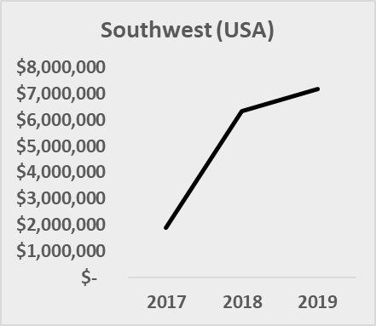
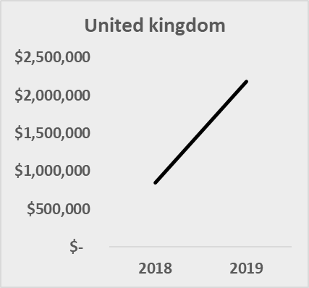
Top-Performing Regions :
Northwest, Leading with over ₪1.6M in annual sales , Central, Close behind with over ₪1.5M revenue. These regions consistently dominate across multiple years.
Underperforming Regions :
Southeast lags behind with sales under ₪700K, yet shows potential through underutilized resellers and missed targets. Frequent target misses in this region suggest either misalignment or lack of enablement
Regions with low reseller density tend to underperform, regardless of population or size.

Slide 7
Resellers performance

Slide 8
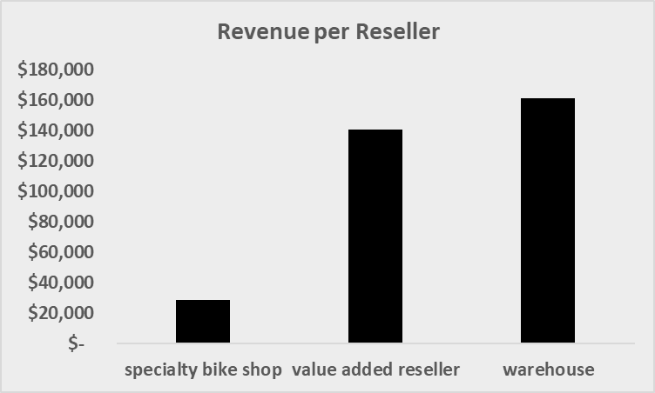
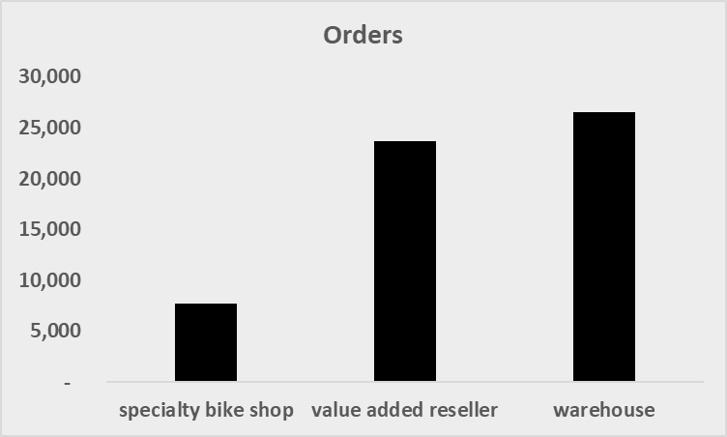
Warehouse Resellers : Generated the highest total revenue (~$37M), making them the most dominant channel. Their success is likely due to bulk ordering capabilities and efficient distribution networks.
Value-Added Resellers (VARs): Ranked second with ~$32M in revenue. While slightly behind warehouses in total volume, VARs offer consultative sales and service bundling, remain vital for high-value or strategic segments.
Specialty Bike Shops: Contributed around $7M, with smaller, more stable revenue. These shops play a niche role and may be best positioned for localized or brand-experience-driven markets.
Urban Advantage: Resellers in urban areas outperformed rural counterparts, with top performance clusters in the Northwest and Central regions.
Distribution Gaps: Underperforming areas (e.g., Southeast) had low reseller presence, correlating with frequent missed targets and weak sales. Introducing more Warehouse or VAR partners in these regions could unlock hidden potential.

Slide 9
Product attributes correlation

Slide 10
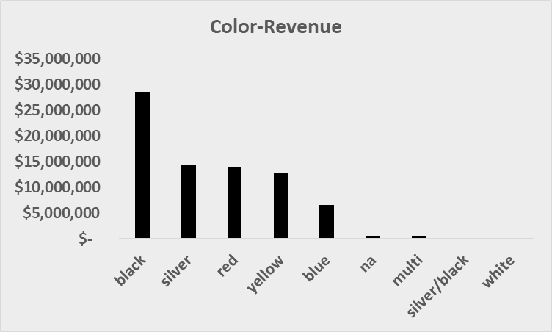
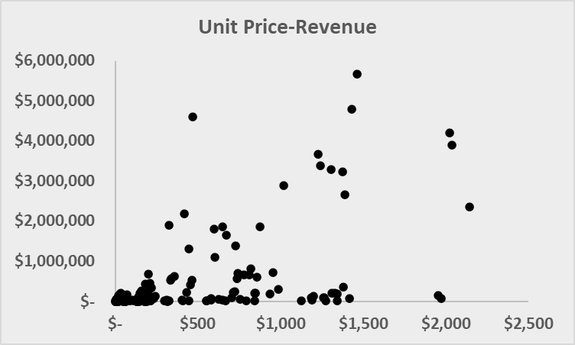
Product Color vs. Revenue : Black, silver, red and yellow were the top-performing colors in total revenue, together accounting for over ₪65M+.
Colors like white and multi-color had minimal contribution to revenue.
Popular colors drive volume (e.g., black, silver). Premium colors (e.g., multi, white) may serve niche or premium segments, but don't significantly lift total sales.
Unit Price vs. Revenue : Higher-priced products don’t always generate higher total revenue.
Most Products that generated more than 2M $ In revenue had average price between 1000$ to 1500$
There's a non-linear relationship – optimal revenue is achieved in mid-high price bands, not the most expensive ones.

Slide 11
Overall trends and patterns

Slide 12
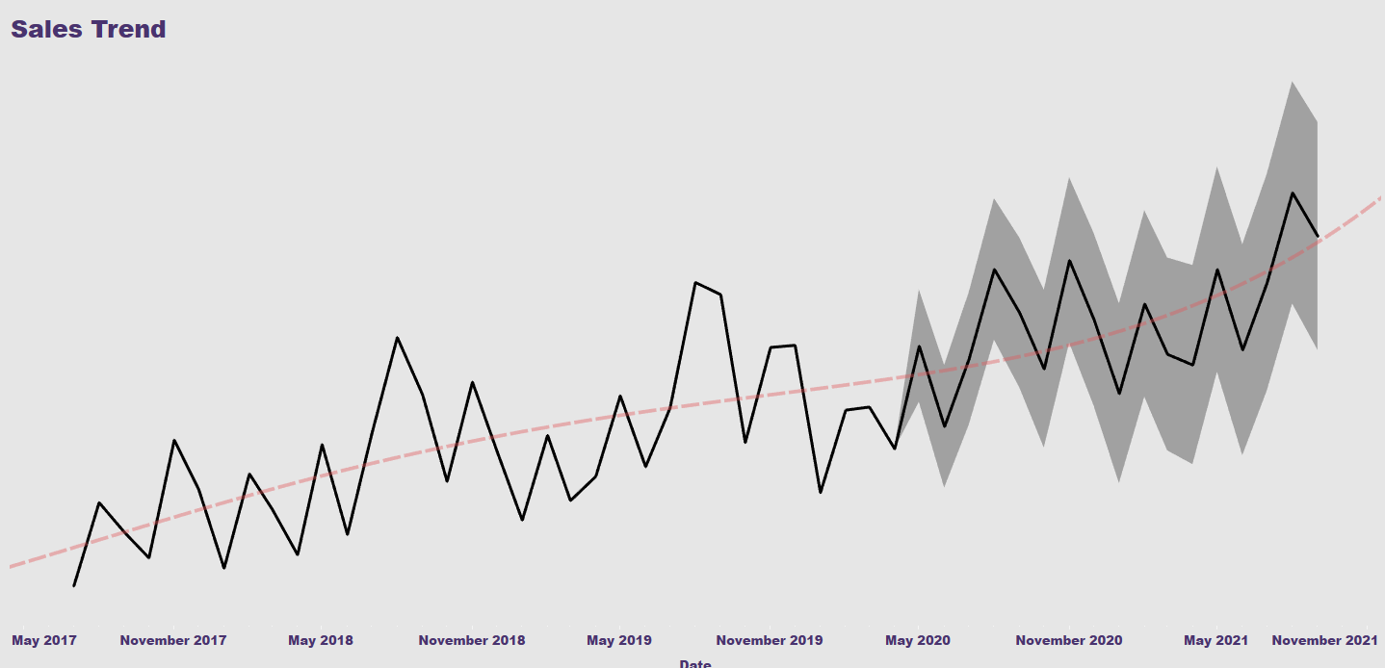
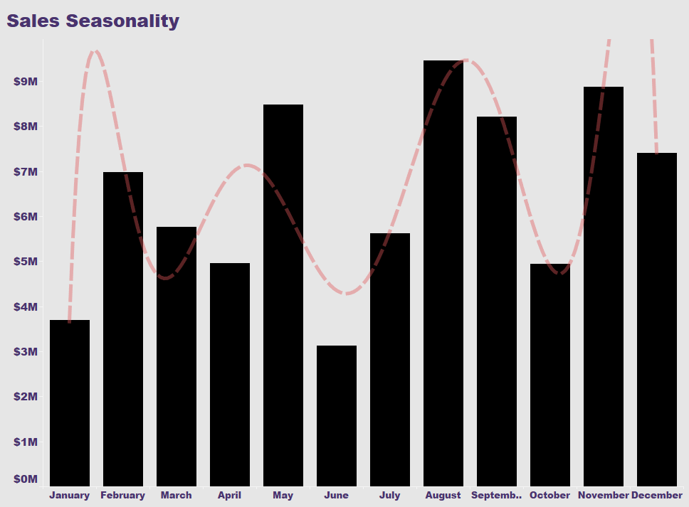
strongest in the Northwest, with both sales volume and profitability increasing steadily.
The Northeast showed an uptick in recent quarters, hinting at future opportunity if invested in correctly.
YoY Reseller Growth : VARs showed steady annual growth, especially in high-potential territories. Performance consistency suggests these resellers can be leveraged further for campaign rollout, bundling offers, or new product introductions.
Steady Year-over-Year Growth .
Overall revenue increased consistently between 2017 and 2019.
Seasonality Detected - Strong sales spikes observed in May, July, and September, indicating strong seasonal demand cycles.
Q2 (Apr–Jun) and Q4 (Oct–Dec) are consistently the strongest quarters across years.

Slide 13
Key strengths and weaknesses

Slide 14
strengths
weaknesses
Profitability Gap in Bike Category - Although Bikes generated over ₪25M, they resulted in a net loss (~₪487K), mainly due to the unprofitable Road Bikes segment.
Regional Underperformance in Southeast - The Southeast region showed sales under ₪700K and frequent target misses, correlated with low reseller density and weak channel enablement.
Price–Revenue Inefficiency - High-priced products didn’t always yield higher revenue. Most high-performing items were in the 1000$–1500$ range, highlighting missed optimization in premium pricing strategies.
Consistent Growth Trend - Revenue increased steadily year over year from 2017 to 2019, showing a healthy sales trajectory with strong seasonality in Q2 and Q4.
High Profitability in Components Despite lower sales volume, the Components category achieved the highest profit (~₪950K), driven by strategic subcategories like Mountain Frames.
Strong VAR & Warehouse Reseller Channels, Warehouse resellers led revenue with $37M, and Value-Added Resellers followed ($32M), proving highly effective in bulk sales and strategic markets.

Slide 15
recommendations

Slide 16
Short-range
mid-range
Diversify Revenue Through Components & Accessories - Scale up investment in Components and Accessories, which show higher profit margins and growing revenue, signaling a shift toward high-margin, add-on products.
Implement Dynamic Pricing Based on Performance Bands - Analyze top-selling products and develop pricing strategies that encourage volume without sacrificing margins. Consider segmenting products into pricing tiers aligned with customer value perception.
Develop a Regional Playbook for Reseller Enablement - Create training, incentive structures, and targeting models for urban-focused reseller strategies, especially in growing but under-optimized regions. Aim to increase performance consistency across all regions by replicating successful urban cluster patterns.
Optimize Road Bike Offering - Review pricing, marketing, and cost structure of the Road Bikes subcategory, which generates ₪11.3M in revenue but leads to a net loss of ₪1.05M. Focus on improving margins through product bundling, promotional offers, or discontinuation of low-performing segments.
Expand in High-Potential Regions (e.g., Southeast)Deploy more Warehouse and VAR resellers in underperforming areas like the Southeast, where low reseller density correlates with poor sales and frequent missed targets. Leverage successful models from Central and Northwest regions as blueprints.
Leverage Peak Sales Months - Align marketing campaigns, inventory, and promotions with high-performing months (May, July, September).Focus on Q2 and Q4, which show consistent demand surges across years.

